Slide 1
Benredia 2020 Performance Report
Kyle Lucero
Notes:
Hi i’m kyle
Thankyou for taking the time in interviewing me
I look forward meeting getting to know you all

Slide 2
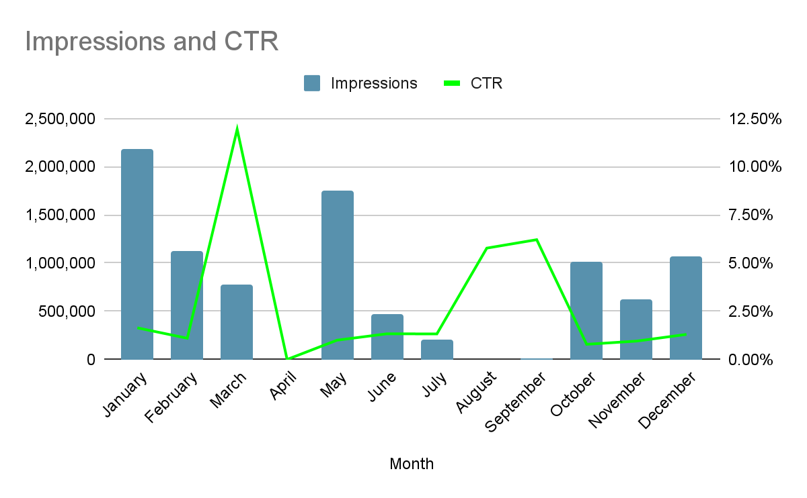
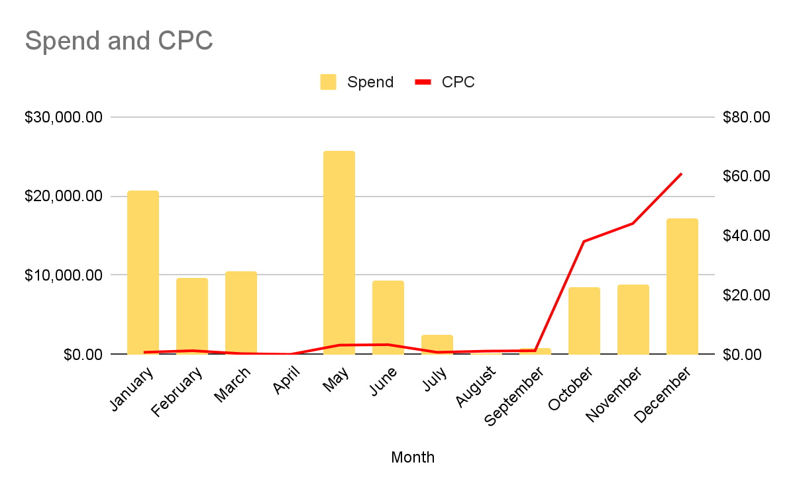
Campaign Overview
Notes:
Campaign performance of 2020
Jan started strong comprising of the majority of impressions
When looking at MoM performance, march led in engagement
One thing to call out is that april has no data points, not sure if the campaign went dark or if there were data collection issues. Further investigation would be required
Summer months have stable and strong engagement, as a result it is the most cost efficient. We can consider increasing investment in order to boost impressions overall
During Q4 we can see that impressions were relatively stable, however engagement was low. This is most likely due to holiday timing, a dead giveaway is the escalating CPC towards the end of the year
Notice how the CPC is stable until Q4
WHERE SHOULD I PUT MY MONEY?
We should increase investment during the months that display strong engagement such as aug-sep and march

Slide 3
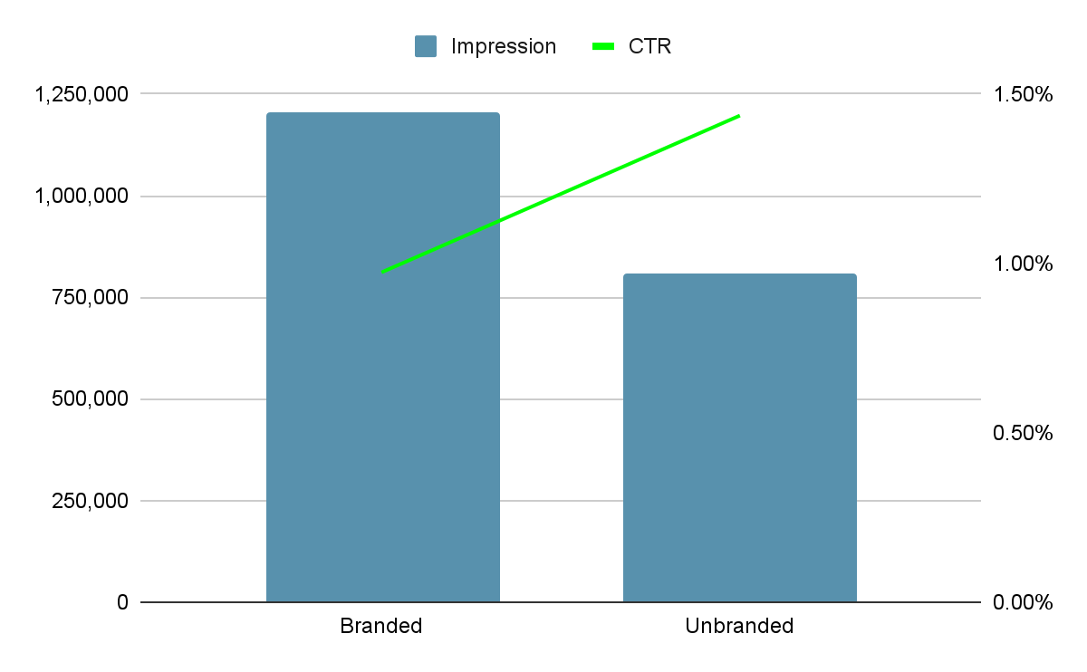
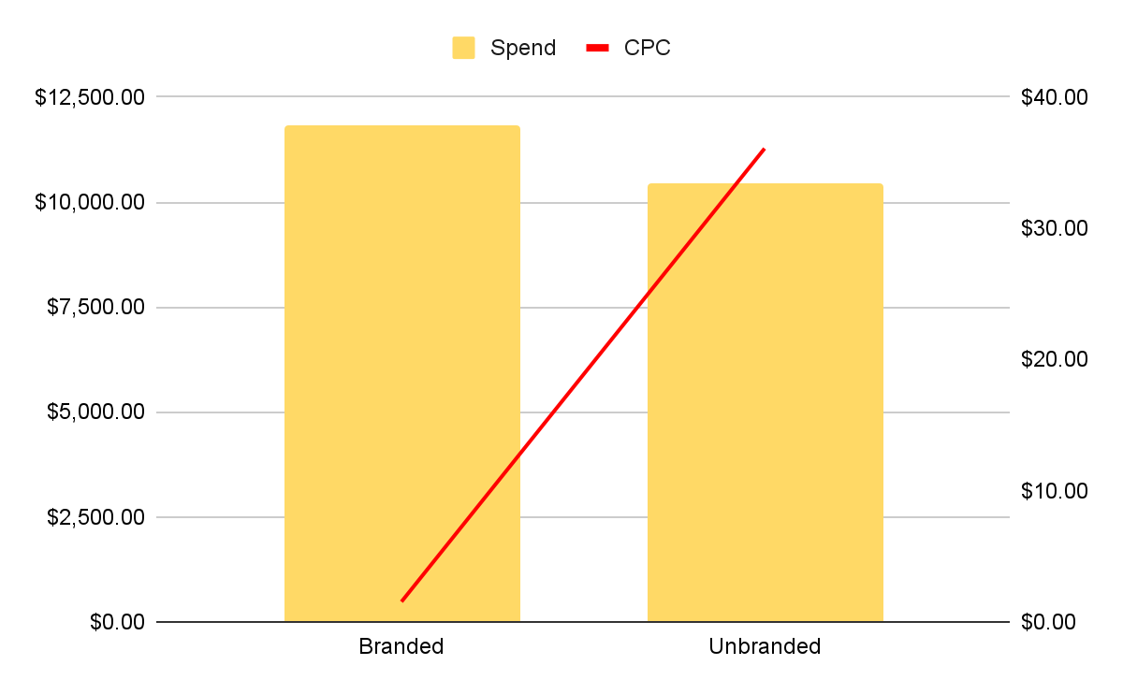
Branded vs Unbranded
Notes:
Combine CPC and CPM
Unbranded led in performance because they had the higher engagement, even tho they were less cost efficient
Branded comprised of the majority of impression and was the most cost efficient
Users are more engaged in the unbranded campaign
WHICH BRAND WAS BETTER?
unbranded

Slide 4
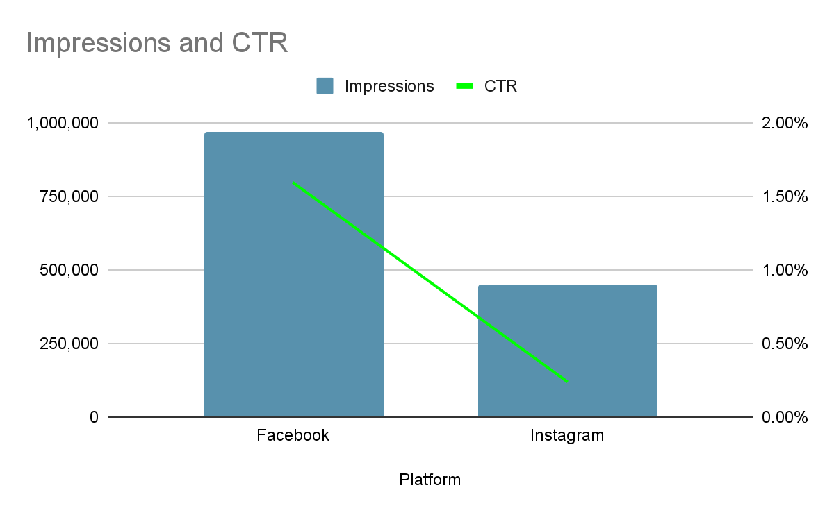
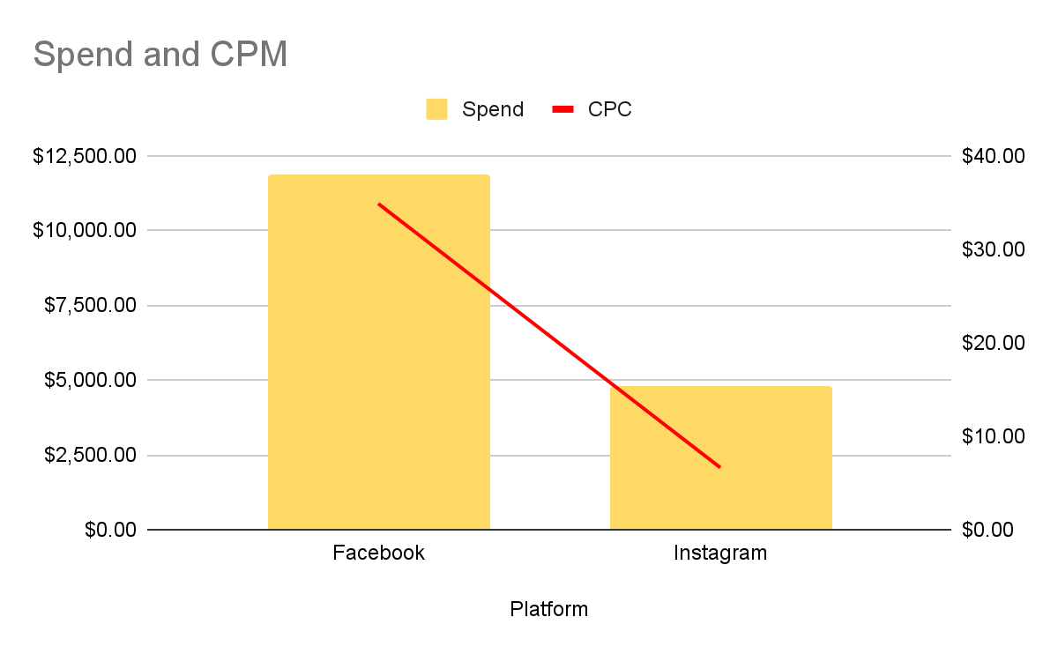
Platform Performance
Notes:
*Get rid of cpm
Facebook outperforms instagram by a significant amount, but it comes at premium as seen in the CPC
It leads in engagement and CTR, but we also spent a lot of money and cost high per click
We should continue investing in fb, but there is still room for optimizations on instagram
WHICH PLATFORM WAS BETTER?

Slide 5
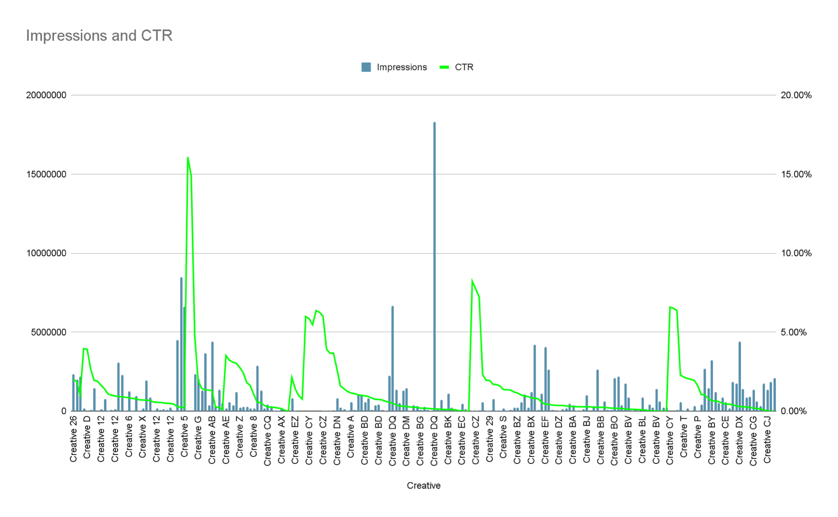
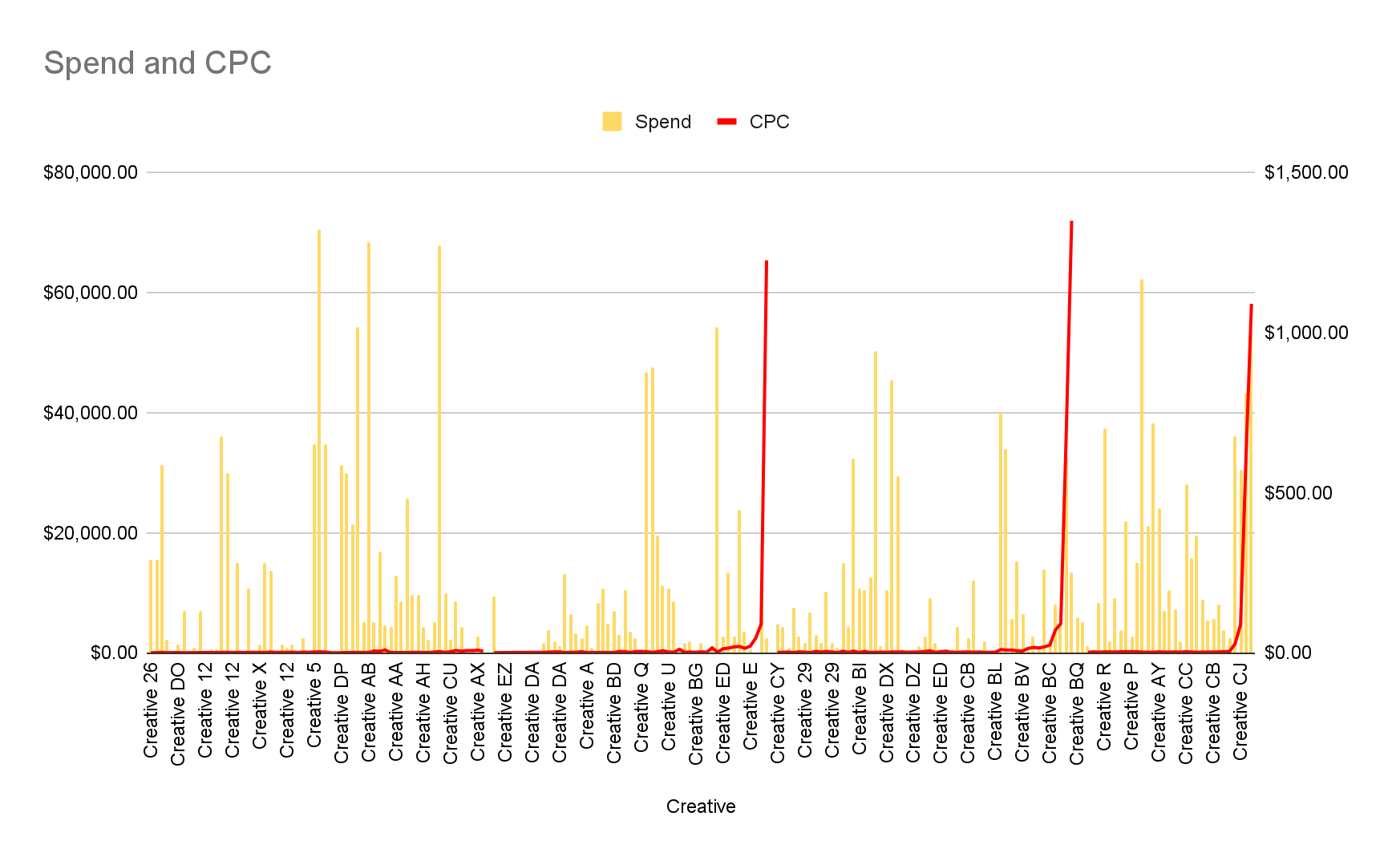
Creatives
Creative 5 Successful
Creative AJ
Failed
Notes:
*Fix axis
*contrasting colors on each graph
*on top of eachother and stretch
*keep general
*top five supplement
Ctr cpc
*add how they perform on on the same slide, highlight the best and worst draw box around it
AJ had the lowest impressions and CTR, failed creative
Creative 5 had good impressions and CTR, successful
WHERE SHOULD I CUT? WHAT MORE CREATIVE SHOULD WE INVEST?

Slide 6
Insights
Invest in August-September and March to boost impressions
Q4 had a high CPC and low engagement
March had the best CTR rate, optimal click/impression ratio
Unbranded outperformed Branded
More money spent resulted in more impressions, but Branded was more cost efficient
Unbranded had a higher CTR, still room for optimization towards cost efficiency
Facebook lead in performance
Facebook had a higher CTR, but this comes at a price
Optimizations can be made towards instagram; it is more cost efficient but has lower engagement
Pause on Creative AJ, Continue Investing in Creative 5
DQ had the highest impressions
AJ had the lowest impressions and CTR rate, failed creative
Creative 5 had good impressions and CTR rate, successful creative
Notes:
PUT KEY TAKE AWAYS
And that concludes my presentation

Slide 7
That Concludes My Presentation
Thank you
Notes:
PUT KEY TAKE AWAYS
And that concludes my presentation

